Slide 1

Behavioral Health Planning and Advisory Council
October 11, 2023

Slide 2
Presented By:
Dan Heit
President & CEO
JusticeWorks YouthCare
Dipesh Chauhan
Director of Program Development
JusticeWorks YouthCare
Samantha Gerdeman
Regional Director
JusticeWorks YouthCare

Slide 3

JusticeWorks History
Serving youth and families since 1999
Serving CO, PA, OH, SC, MD, FL
Headquarters in Pittsburgh, PA.

Slide 4

Mission Driven Organization
“Do Whatever it Takes” ideology
Family-centered
Strength-based
Solution-focused
Outcomes-based
Trauma-informed

Slide 5
Components
Assessments
Programming
Partnership & Collaboration
Community
Sustainability

Slide 6

FAMILY AND COMMUNITY ENGAGEMENT
Family engagement is a strengths-based, anti-oppressive approach to child welfare whereby families are empowered as partners in setting goals, developing case plans, finding solutions, making decisions, and keeping children and youth safe.
Engaging communities to support families expand the available resources for all and fosters a sense of collective responsibility for the well-being of its children. Furthermore, engaging with communities creates opportunities to address the broader issues that put families at risk.
All families deserve opportunities to build access to what they need emotionally, socially and physically in order to parent their children well!

Slide 7
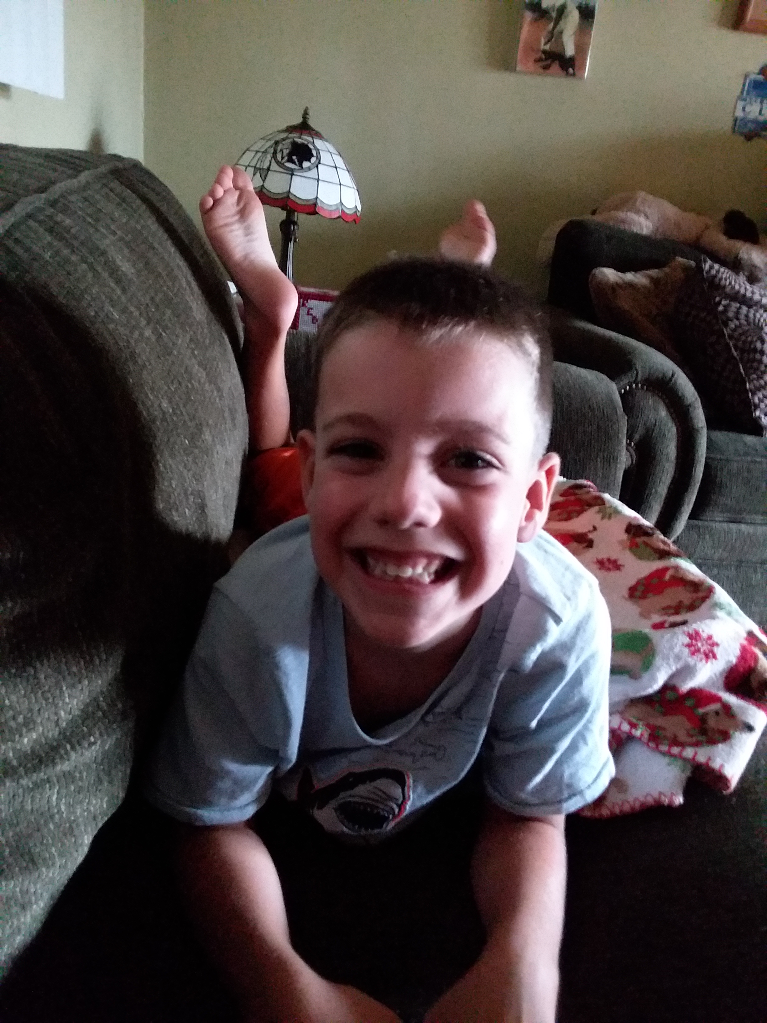
Family First ACT
Family First ACT
Long-overdue historic reforms to help keep children safely with their families and avoid the traumatic experience of entering foster care, emphasizes the importance of children growing up in families, and helps ensure children are placed in the least restrictive, most family-like setting

Slide 8

Our Signature Programs
JusticeWorks’ Signature Programs serve proactively using family and youth strengths to overcome challenges and remove barriers

Slide 9
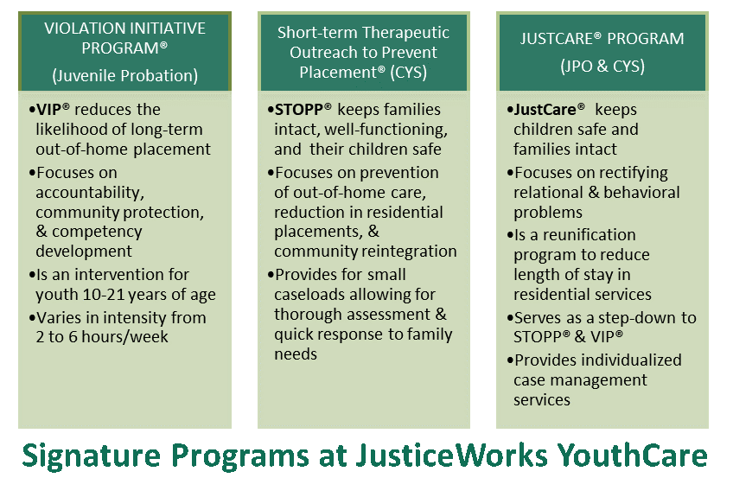
Signature Programs at Justice Works Youth Care

Slide 10
Research-Informed Programs
●Triple P
●Thinking for a Change (T4C)
●Healthy Families of America (HFA)
●Nurturing Parenting
●Aggression Replacement Training (ART)
●Seeking Safety
●Voices
●Visit Coaching
●Family Group Decision Making (FGDM)
●Family Finding (Kevin Campbell Model)
●Truancy Remediation (WhyTry)

Slide 11
WE ALSO PROVIDE:
Independent Living
Supervised Visits
Re-entry Program
Transportation
Alternative Education (Compass Academy)
Statewide Adoption Network (SWAN)
Youth Employment Services (YES Program)
Casework Field Coach Program
Plan of Safe Care
MADE (Crisis Support Sitters Service)
Drug Testing Services
Housing Assistance Support

Slide 12
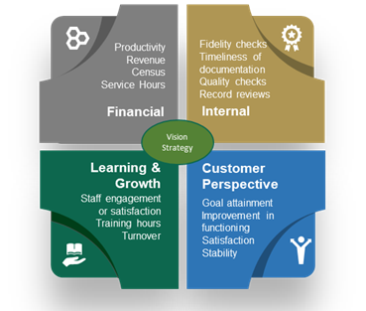
Quality Assurance
We actively engage in quality assurance endeavors to ensure adherence to policies, practices, and procedures in the delivery of services using a variety of methods and strategies to determine what the current performance levels are and where improvement may be needed.
*Outcome Reports Available
We actively engage in quality assurance endeavors to ensure adherence to policies, practices, and procedures in the delivery of services using a variety of methods and strategies to determine what the current performance levels are and where improvement may be needed.

Slide 13

How is Quality & Fidelity Captured?
In-Field Supervision/Coaching
Satisfaction Surveys
  Families/Individuals
  Stakeholders
Quality Checks

Slide 14


Q & A Phase
Questions?
Comments?

Slide 15
Thank you!
Contact us!
Dan Heit
DanHeit@justiceworksyouthcare.com
Dipesh Chauhan
Dchauhan@justiceworksyouthcare.com
Samantha Gerdeman
Sgerdeman@justiceworksyouthcare.com

